Slide 1

Group 03’s Study Buddy
Anika Siddiqui Mayesha (Team Lead)
Rumaysa Babulkhair
Yurii Sykal
Lorenzo Palleschi

Slide 2
Agenda
Figma — Design Evaluation and Evolution
LLM Research
Weekly Retrospective

Slide 3
Figma Design Evolution: User Evaluation

Slide 4
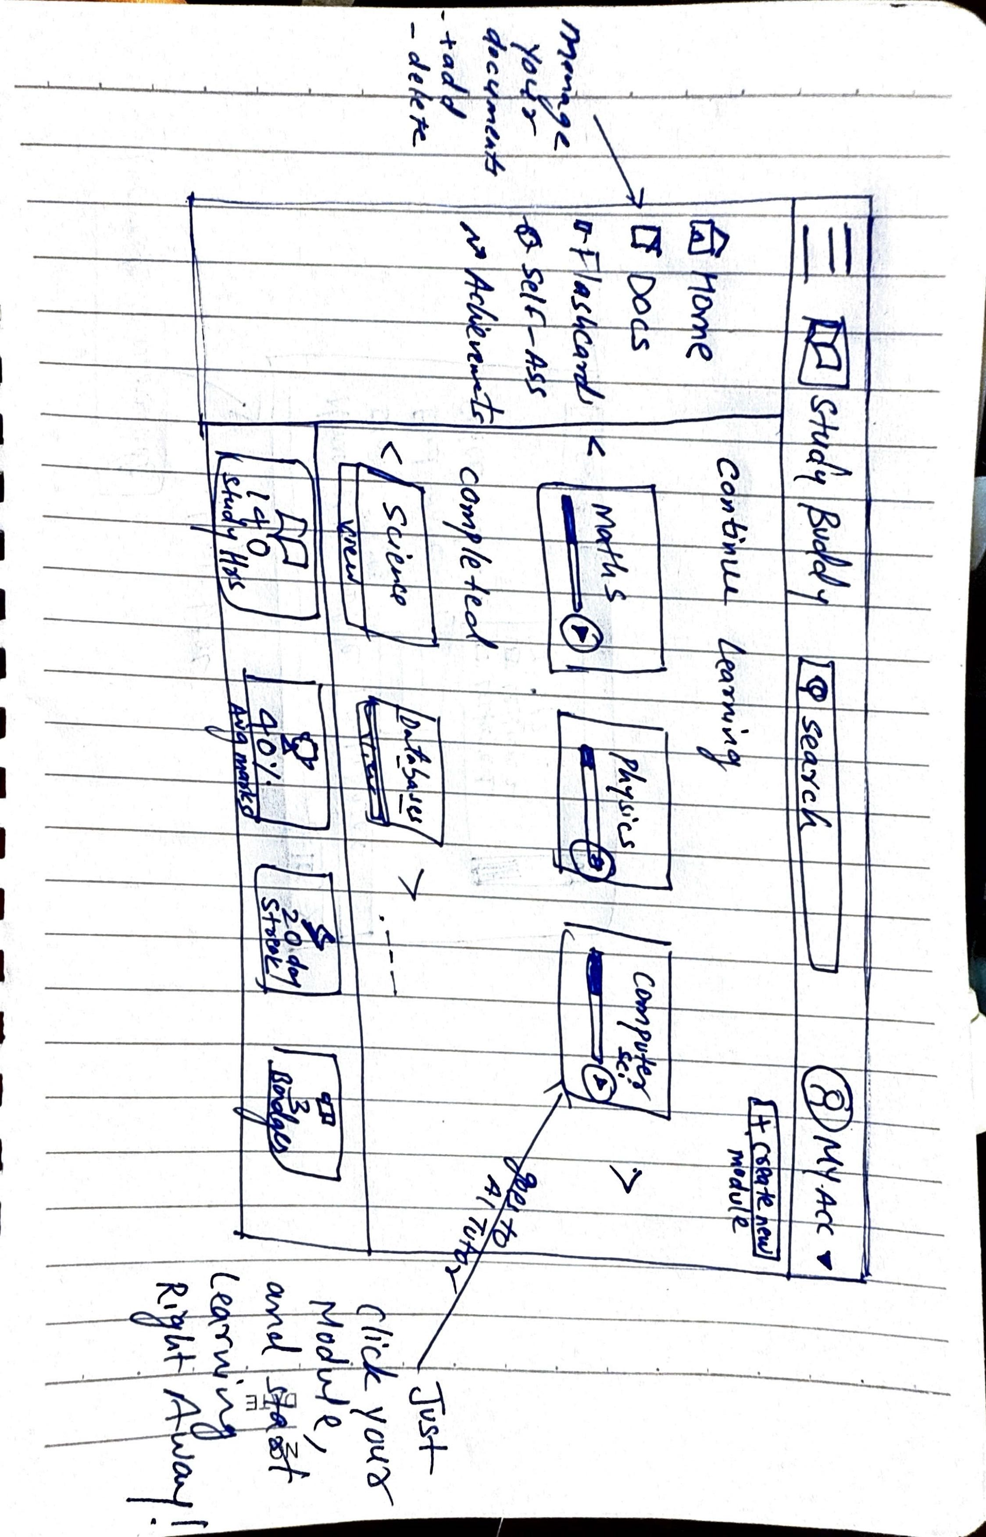

Slide 5
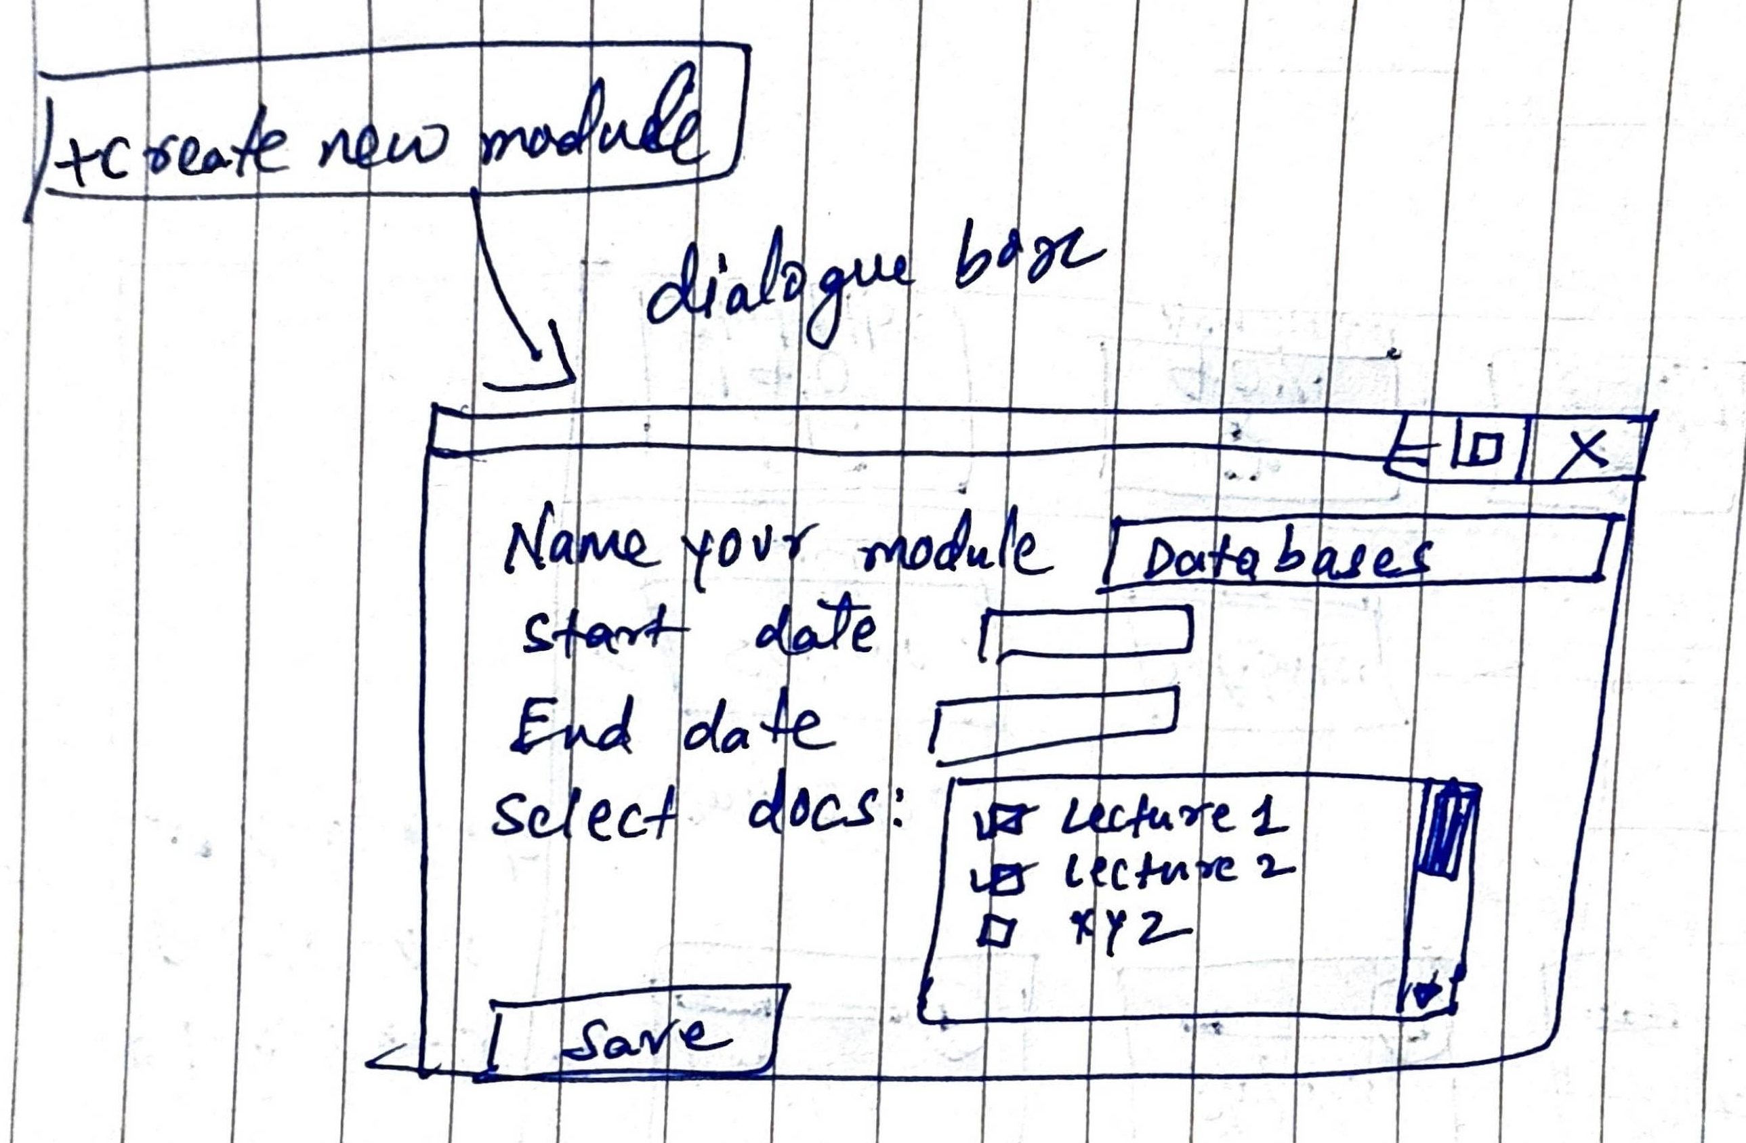

Slide 6
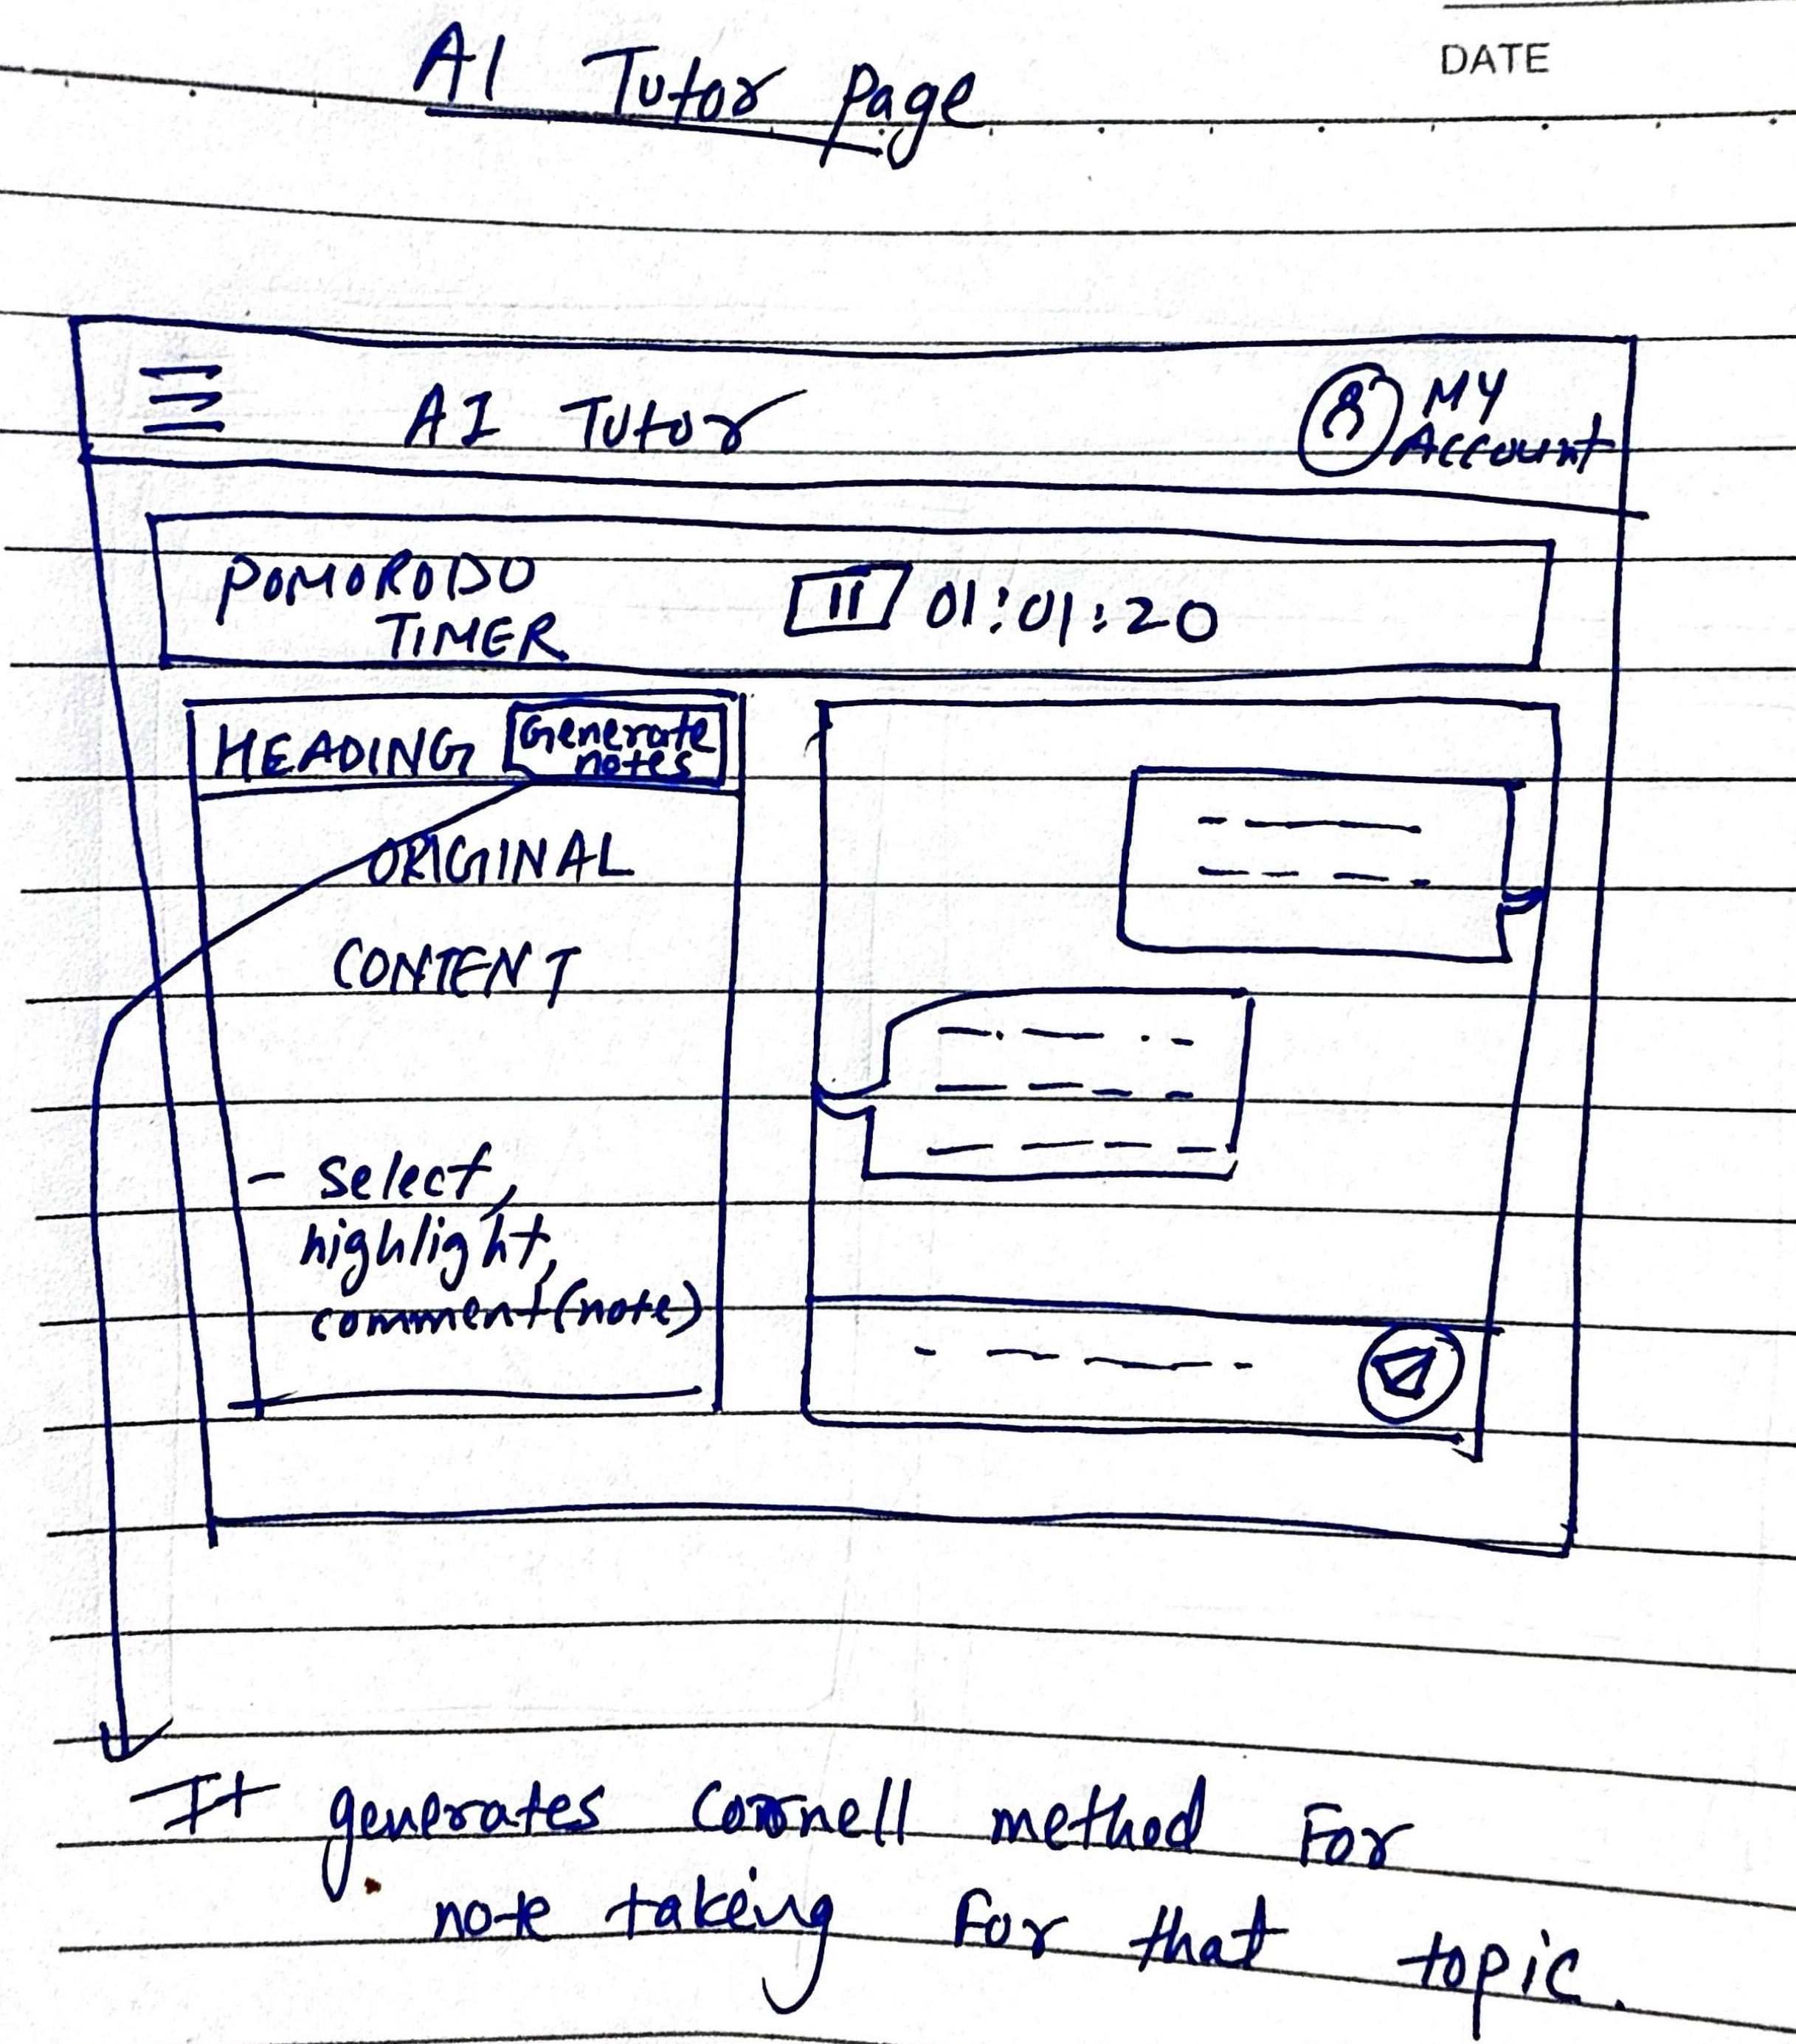

Slide 7
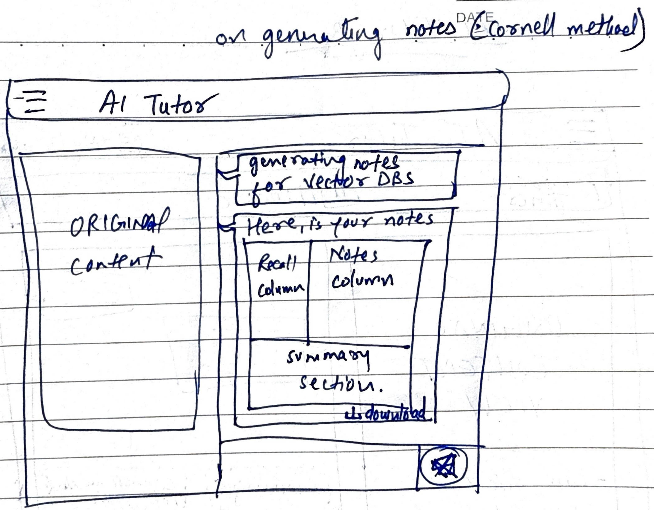

Slide 8
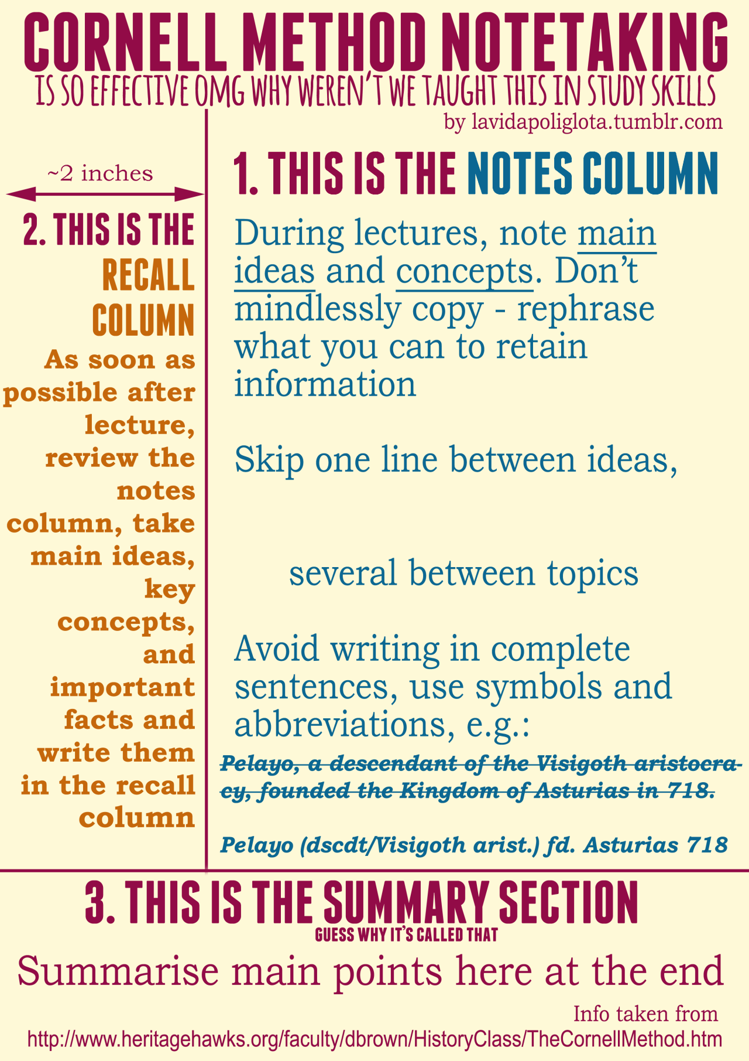
Study Method — Cornell Note‑Taking

Slide 9
LLM Research — Study Assistance

Slide 10
What the Study Assistant Must Do
Explain
Explain clearly with step‑by‑step reasoning and cite sources (Cognitivism).
Adapt
Adapt to the learner’s pace and provide feedback/rewards (Behaviorism).
Support
Support collaboration and building on prior knowledge (Constructivism).
Handle
Handle long context from PDFs/notes and answer grounded to retrieved chunks (RAG).
Run
Run affordably; predictable token spend; low latency for Q&A.

Slide 11

Evaluation Criteria
Answer quality: factuality, depth, step‑by‑step clarity, references.
Context handling: long inputs, retrieval grounding, refusal behavior.
Latency & stability: time‑to‑first‑token, streaming, rate limits.
Cost control: tokens per answer, summarization efficiency.
Safety & privacy: handling of sensitive student data.
Ecosystem: tool calling, RAG libraries, SDK maturity.

Slide 12
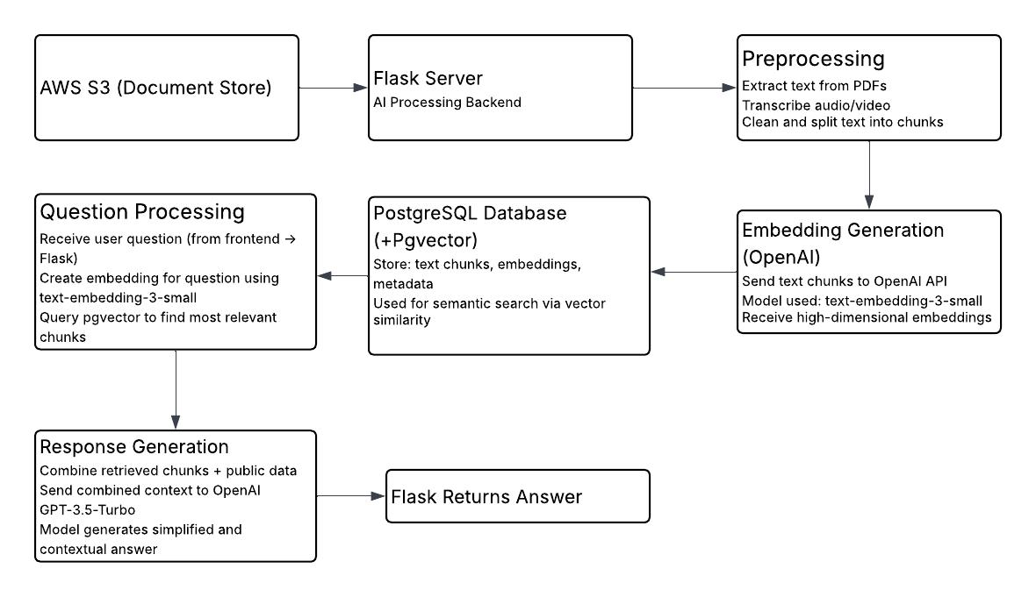
Basic Workflow

Slide 13
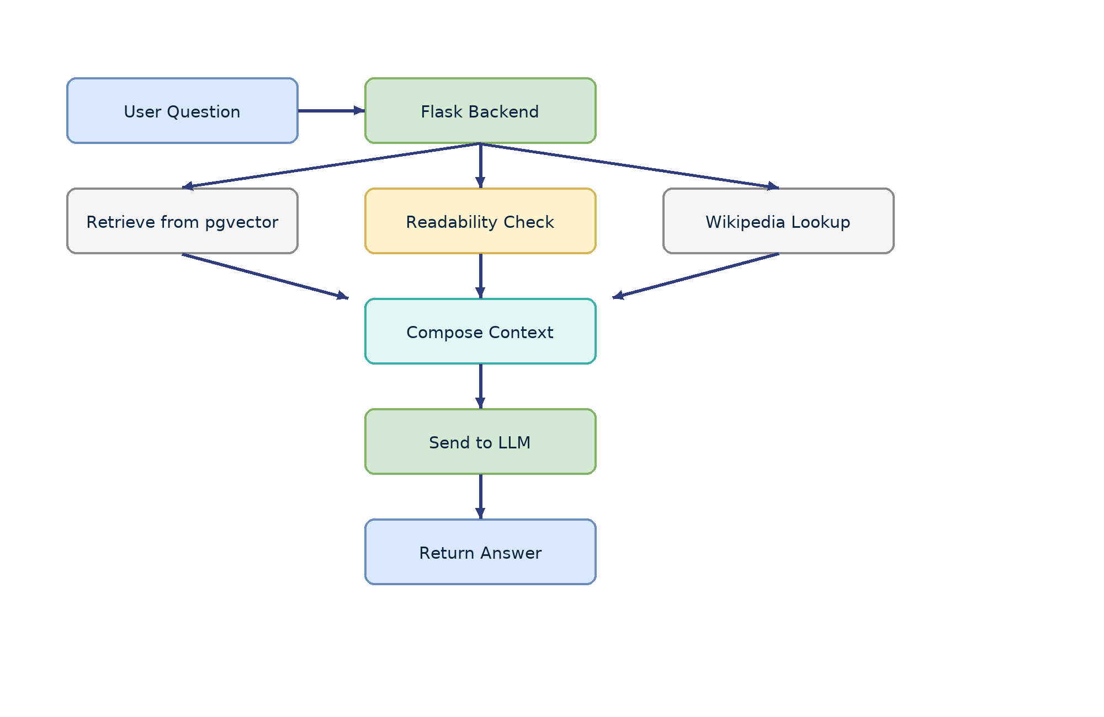

Example
User asks: "Explain Naïve Bayes in simple terms."
Flask embeds question → queries pgVector for relevant lecture chunks.
Flask checks readability/complexity; if tough, fetch a short external description.
Flask searches Wikipedia → gets a 2–3 sentence explanation of “Naïve Bayes.”
Flask composes context: Lecture Notes [chunk] + Public Source [Wikipedia].
Prompt to model: "Explain this concept using both sources in student‑friendly language."
Model (GPT‑3.5‑Turbo) returns a clear, merged explanation; Flask sends to frontend.

Slide 14
Next Steps
Set up pgVector + RAG skeleton; log retrieval context with answers.
1
Run head‑to‑head tests on the 50‑page sample; export to comparison spreadsheet.
2
Decide OneDrive vs S3 for storage; document cost and developer ergonomics.
3
Finalize chunking strategy (≈1k tokens) and evaluation templates.
4

Slide 15
First Publish

Slide 16
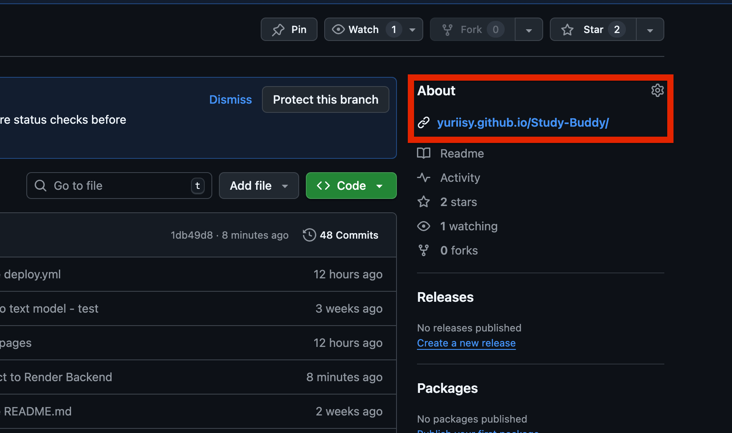
Link in About Section

Slide 17
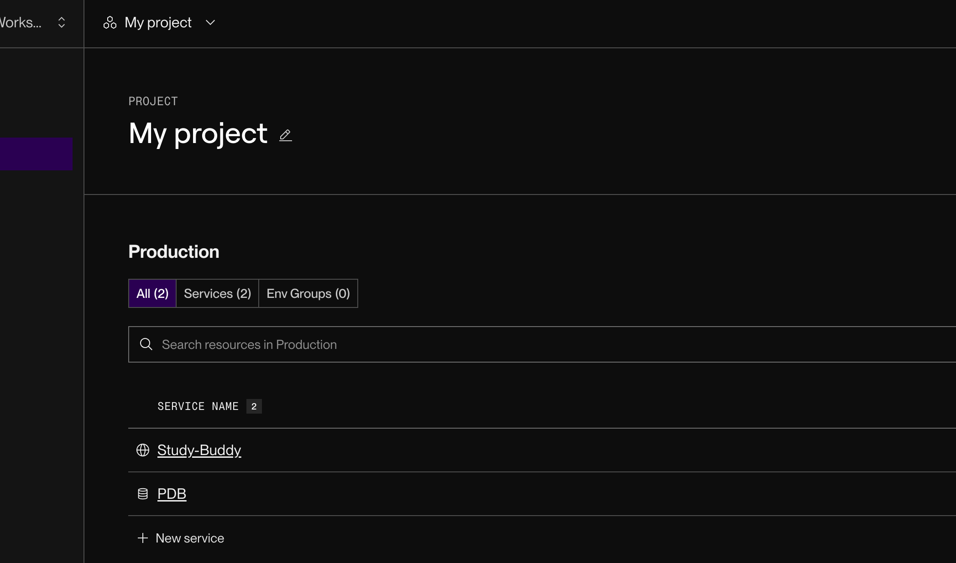
Using Free Hosting

Slide 18
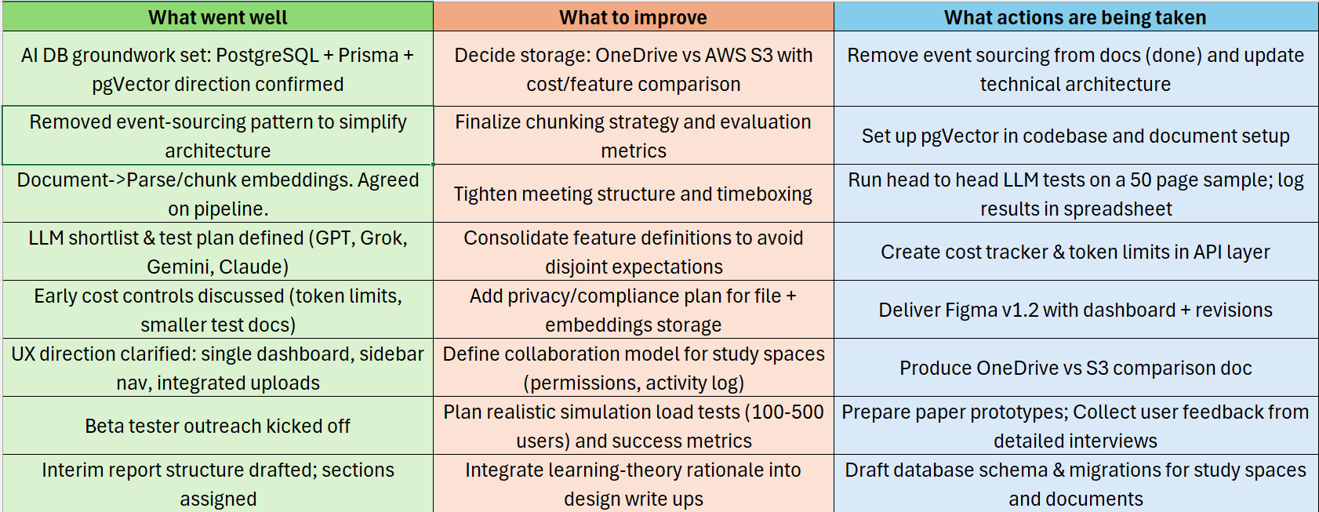
Retrospective — This Week

Slide 19
References
https://ieeexplore.ieee.org/abstract/document/11134904
https://www.techrxiv.org/doi/full/10.36227/techrxiv.175393328.84629021
https://sabapub.com/index.php/jaai/article/view/1052
https://londonic.uk/js/index.php/plic/article/view/282

Slide 20

Any Questions?

